Slide 1
Battery Recycling: DES Characterization
All the Light We Cannot See: Using Infrared to Study Ion Transport in Batteries
Jason M. Porter
Mechanical Engineering Department
Colorado School of Mines
February 22, 2023
Provo, UT
Kevan Williams and William Mulberry
Brigham Young University

Slide 2
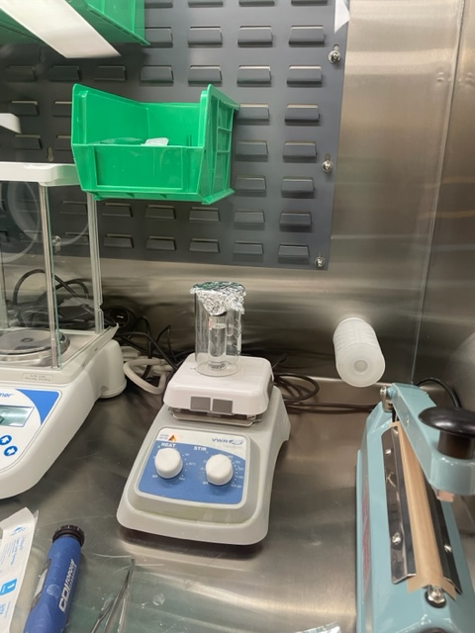
DES Preparation
Each solvent was heated to it’s proper temp in the glovebox for characterization
ChCl:EG 1:2 to 80˚C for 6 hours
ChCl:Urea 1:2 to 130˚C for 12 hours
EG:Citric Acid 2.5:1 to 80˚C for 6 hours

Slide 3
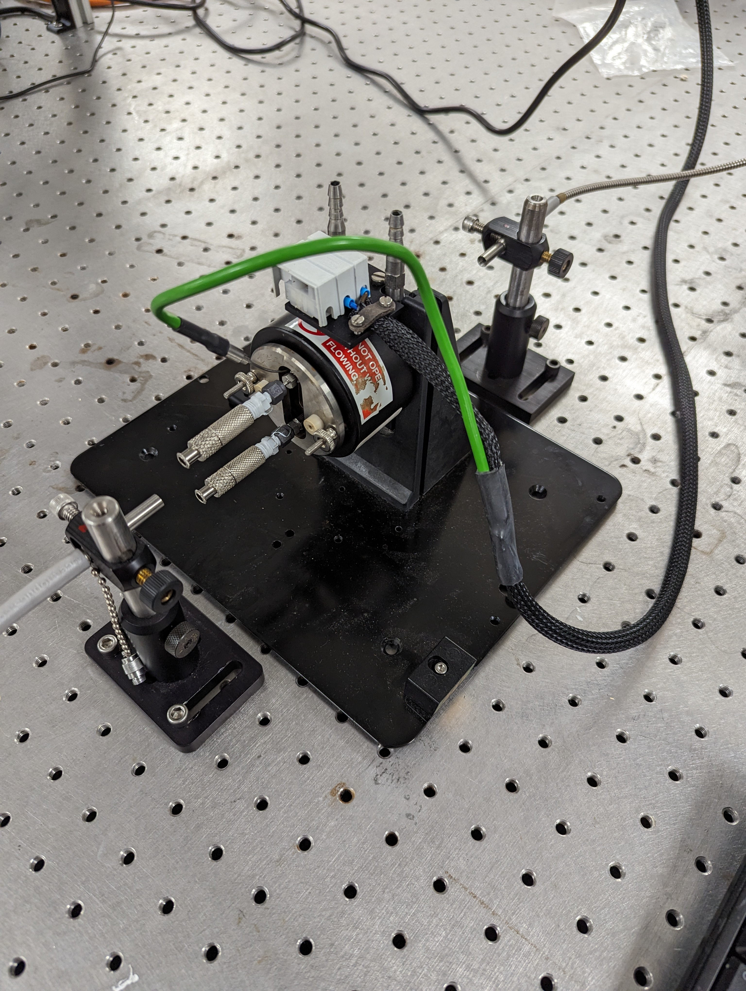
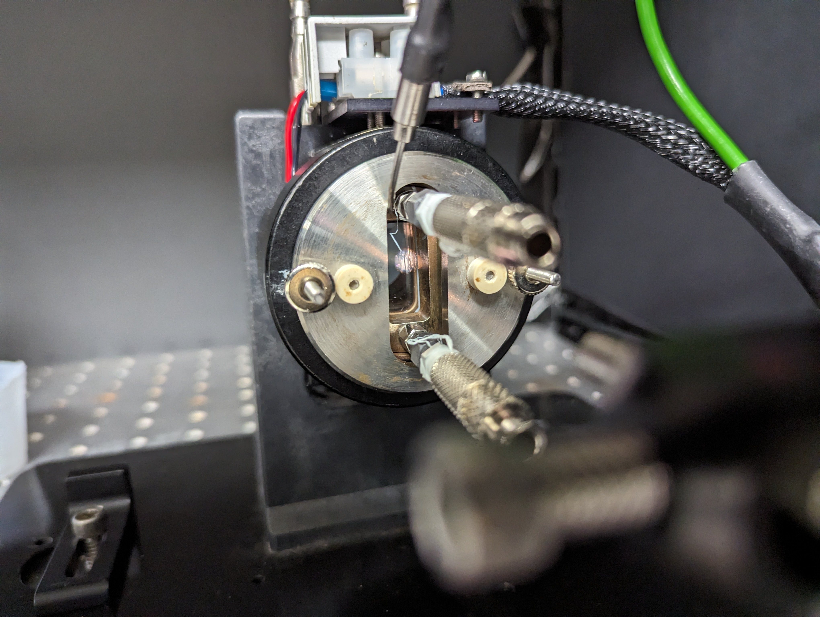
UV-Vis spectroscopy measurement procedures

Slide 4
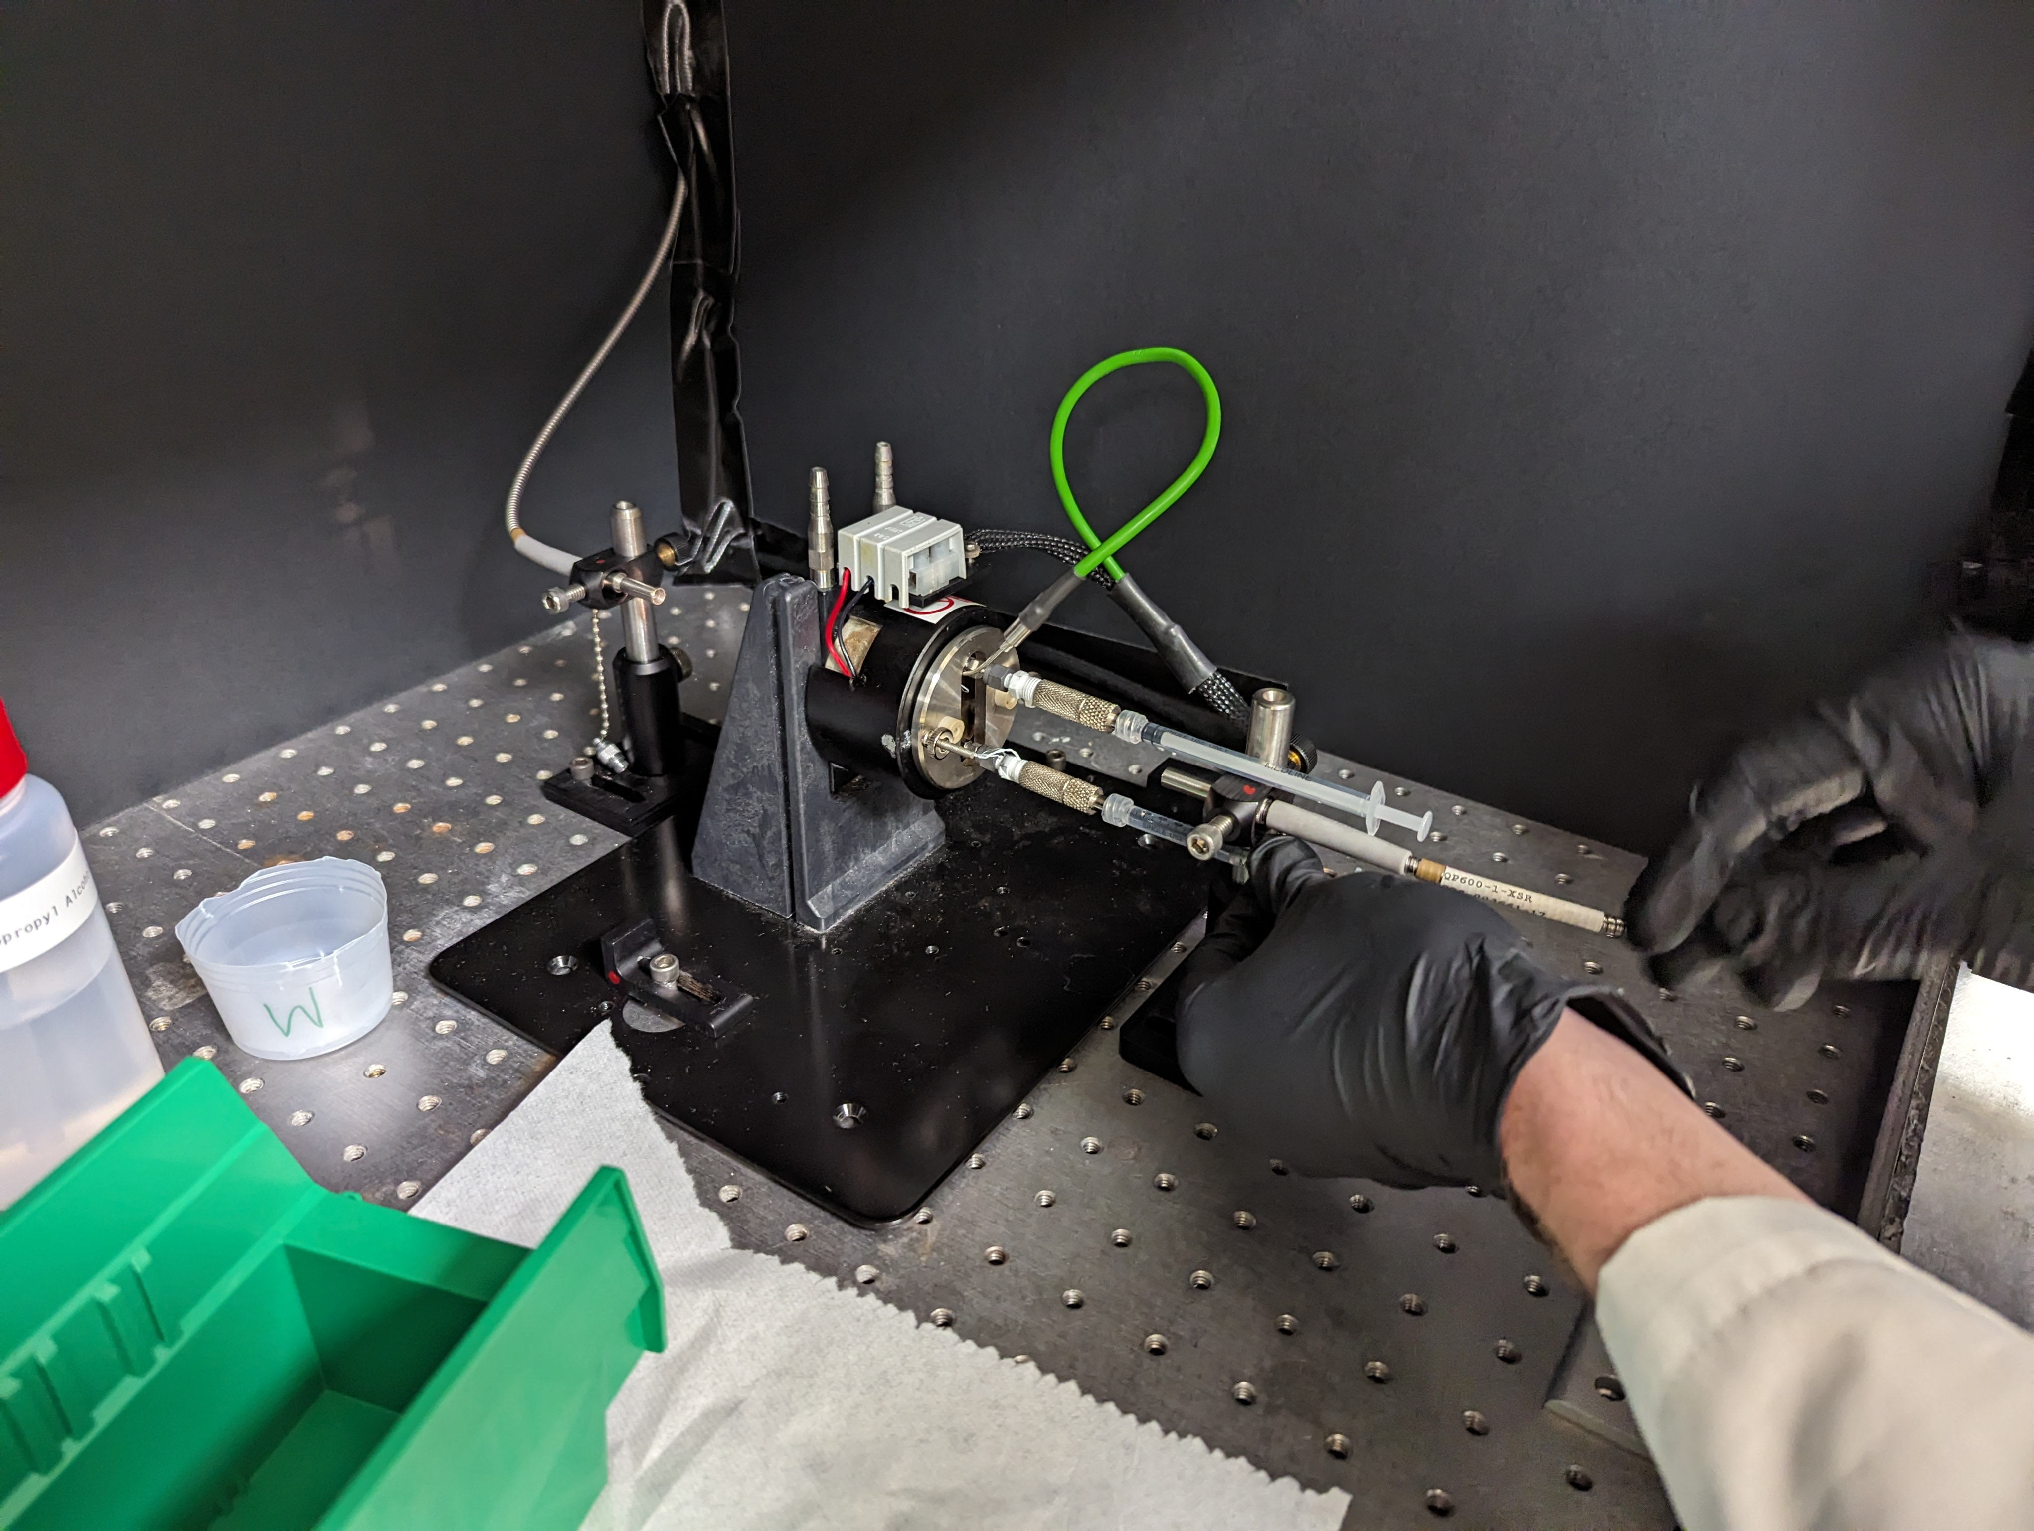
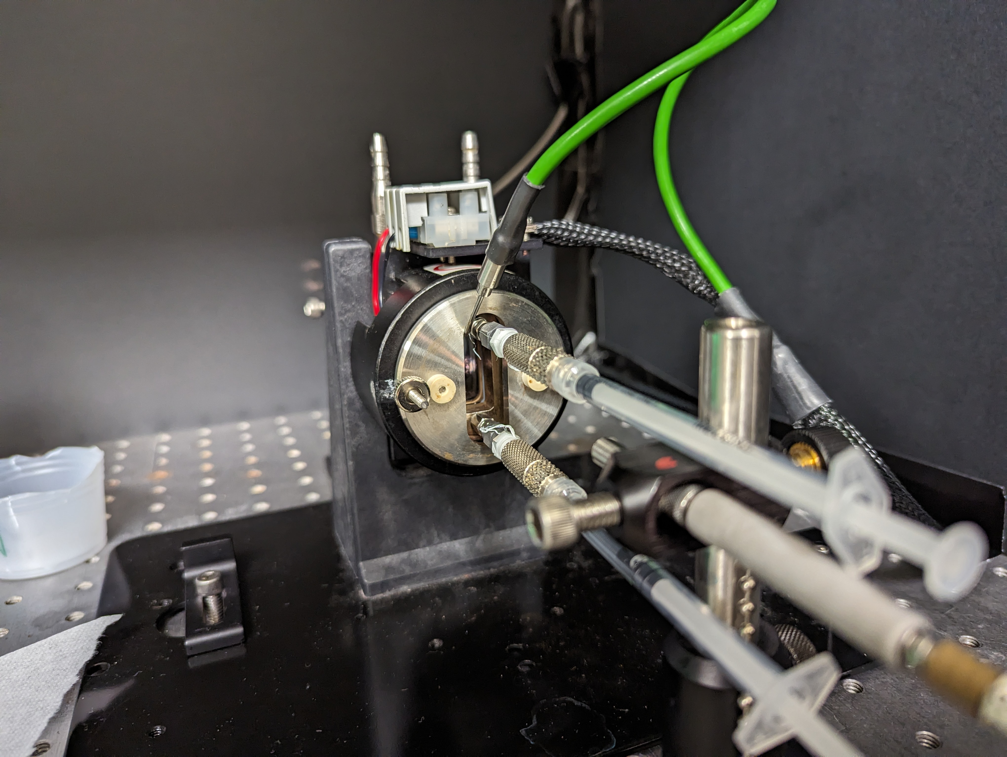
UV-Vis spectroscopy measurement procedures

Slide 5
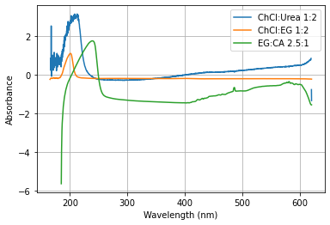
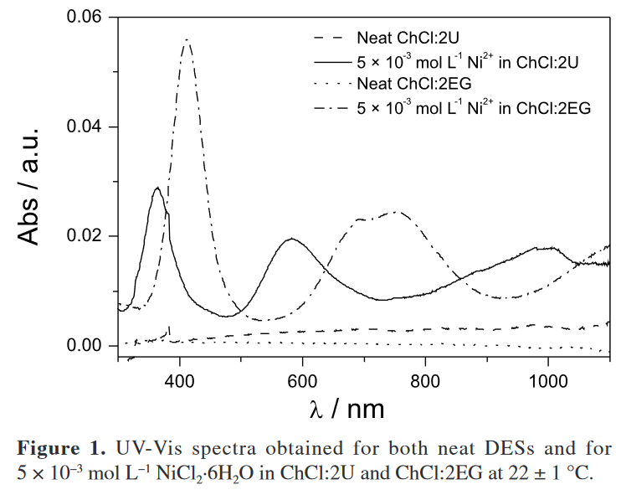
Measurement Results
Urcezino, A., Dos Santos, L., Casciano, P., Correia, A., & De Lima-Neto, P. (2016). Electrodeposition Study of Ni Coatings on Copper from Choline Chloride-Based Deep Eutectic Solvents. Journal of the Brazilian Chemical Society. https://doi.org/10.21577/0103-5053.20160278

Slide 6
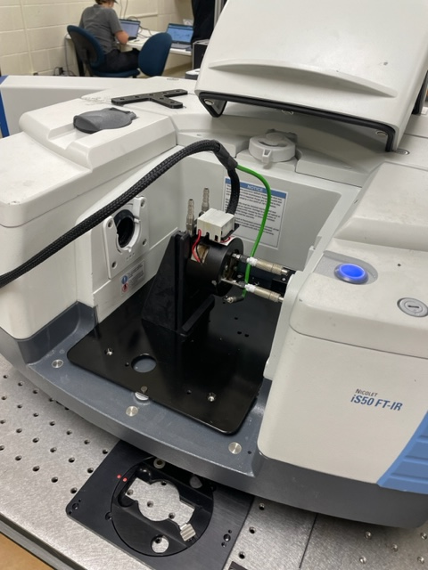
IR Setup and Experiments
Measure previous and new DES’s with IR spectroscopy
Compare results with UV-Vis results to see which is more useful in characterization

Slide 7
Future Experiments
Other solvents (TBD)
Metals dissolved in solvents
3-5 concentrations of dissolved metals

